Slide 1
Progress Update
2022. 11.15
송희수

Slide 2
Patient Sample (Positive)

Slide 3
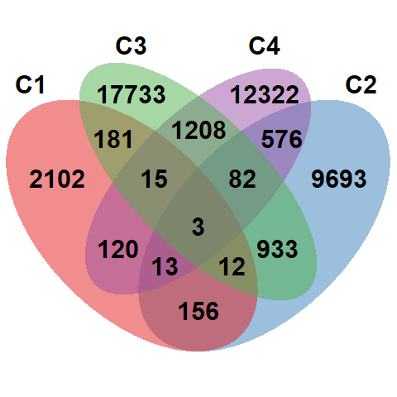
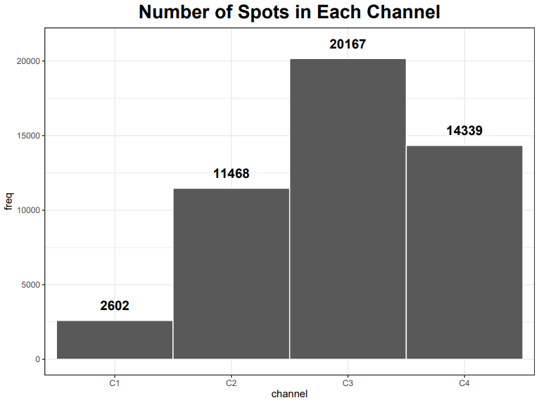
Explore Data (Patient Sample)

Slide 4
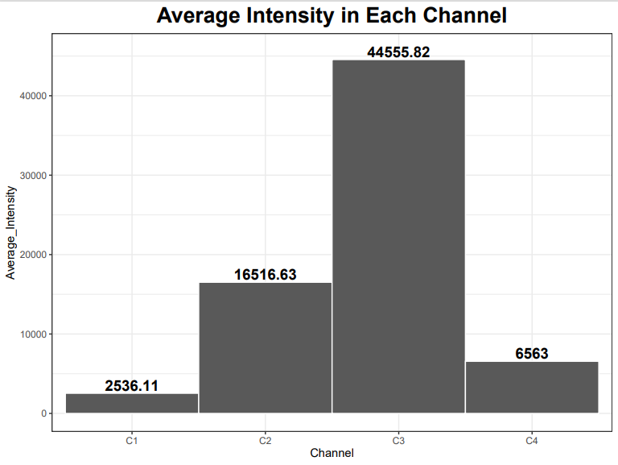
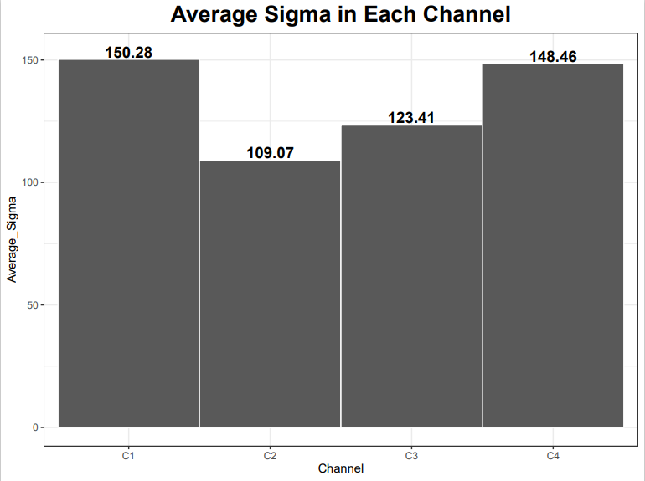
Explore Data – Average sigma/intensity

Slide 5
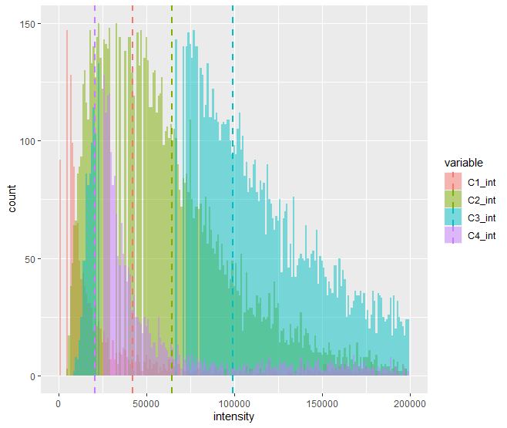
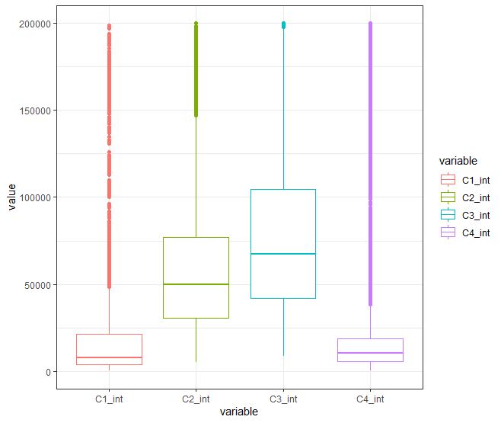
Explore Data – Intensity distribution
Sigma > 0

Slide 6
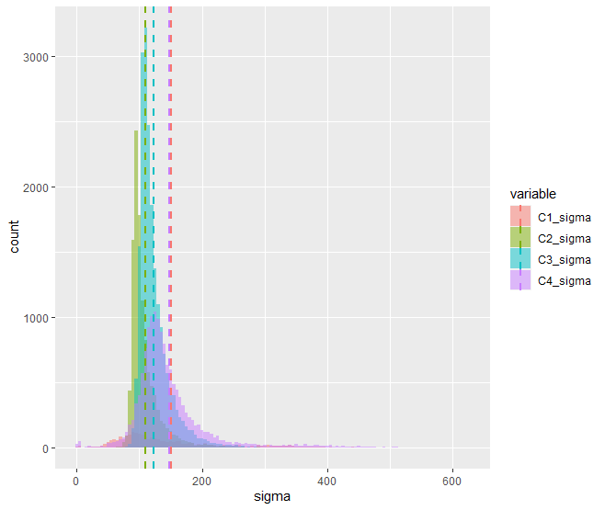
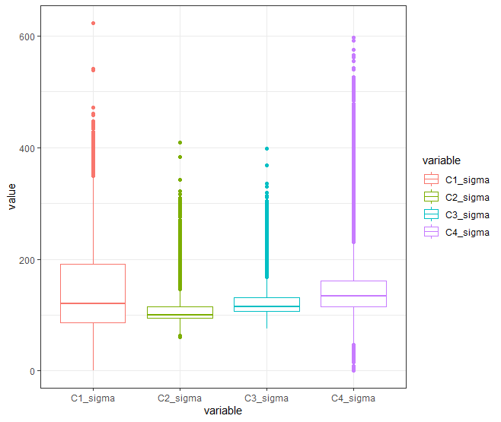
Explore Data – Sigma distribution
Sigma > 0

Slide 7
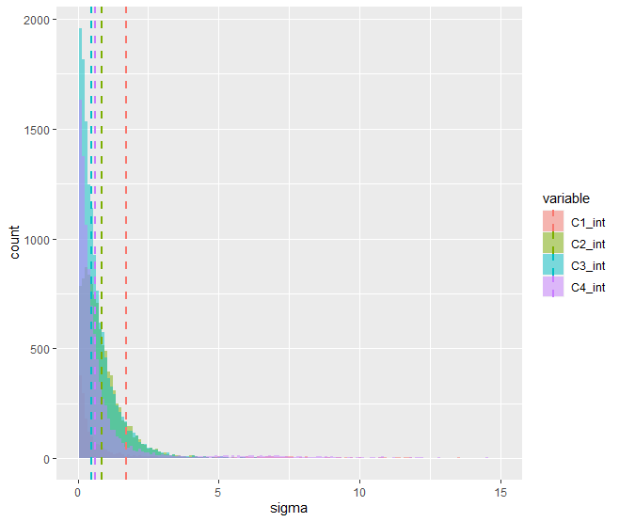
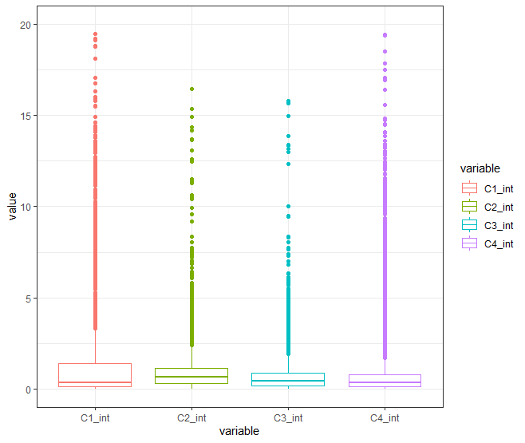
Explore Data – Intensity distribution
After Normalization

Slide 8
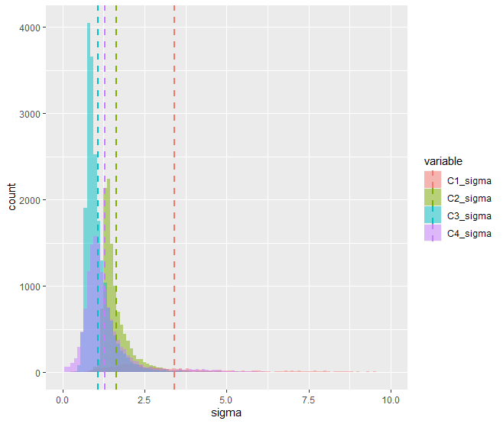
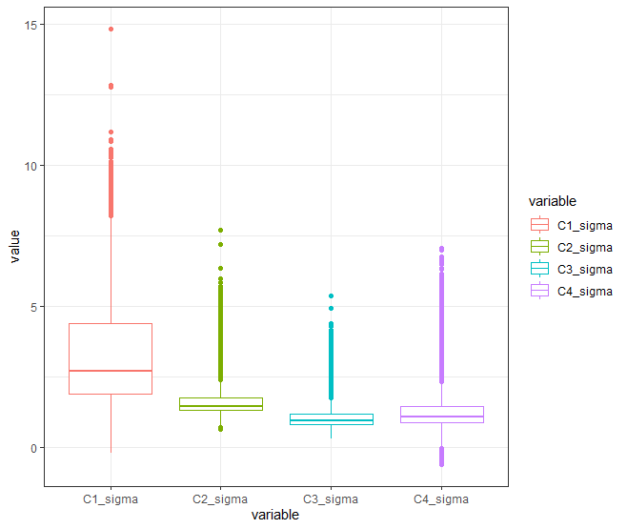
Explore Data – Sigma distribution
After Normalization

Slide 9
Cluster Analysis - Model
Normalized data
Euclidean distance
Observation with certain values of features will be clustered together
Correlation based distance methods (e.g. Pearson corr. Spearman corr.) identify clusters of observation regardless of their magnitude
K-means clustering
Most common clustering method

Slide 10
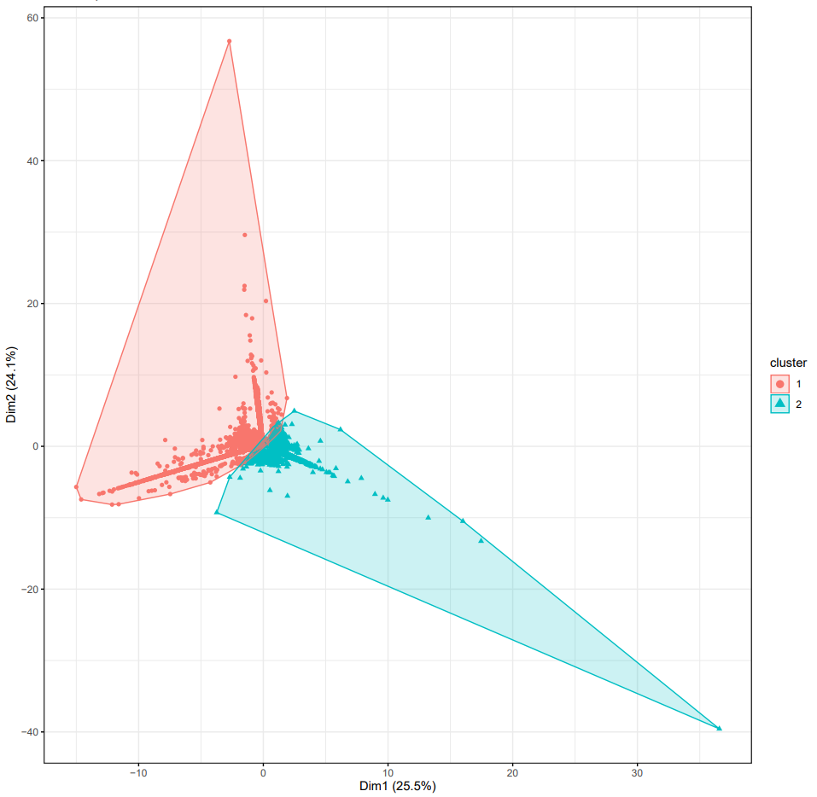
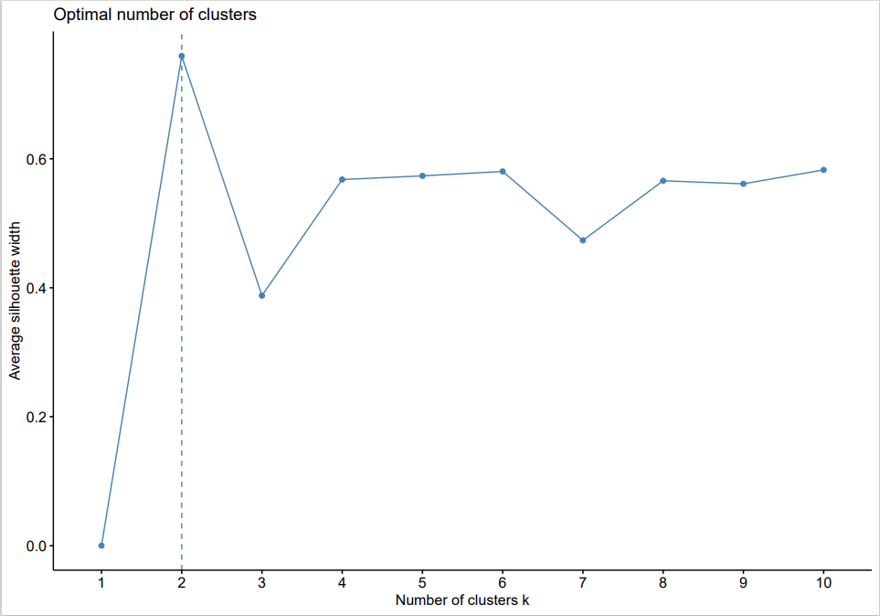
Cluster Analysis (Patient Sample)
Average silhouette coefficient
C1, C2, C4
C3

Slide 11
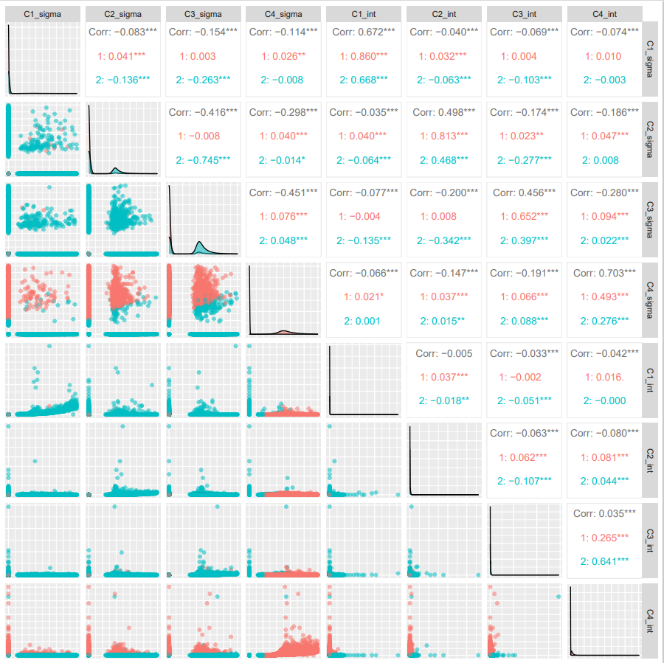
Cluster Analysis (Patient Sample)
Cluster being separated by sigma, not intensity. Especially by C3_sigma.
This can be expected from the sigma/intensity distribution in slide 7&8
High proportion of zero values

Slide 12
Cluster Analysis - Model
Normalized data
Euclidean distance
Observation with certain values of features will be clustered together
Correlation based distance methods (e.g. Pearson corr. Spearman corr.) identify clusters of observation regardless of their magnitude
K-means clustering
Most common clustering method
BUT our data contains excessive zeros (zero-inflated data)
In this case, parametric approaches (e.g. Poisson, NB) may lead to a lack of fit. In case of non-parametric approaches, the excessive zeros create a large number of ties.
Cannot assume normal distribution

Slide 13
Frequency of zeros (전체, 채널 별)

Slide 14
To do
Cluster analysis without unmatched spots
Try different distance/clustering parameters
Microarray digitizing (이규상 박사님과)
쓸 만한 이미지인지 감별하는 standard

